Slide 1
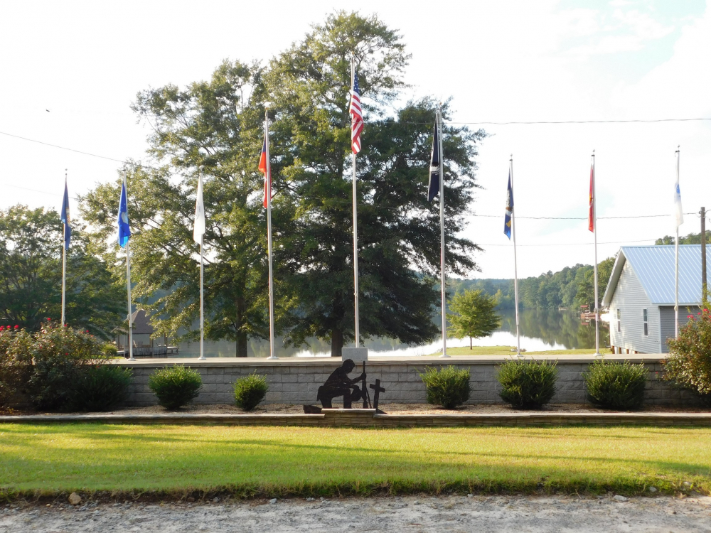
www.facebook.com/American-Legion-Post-70-Villa-Rica-GA-454730741394117/

